Slide 1
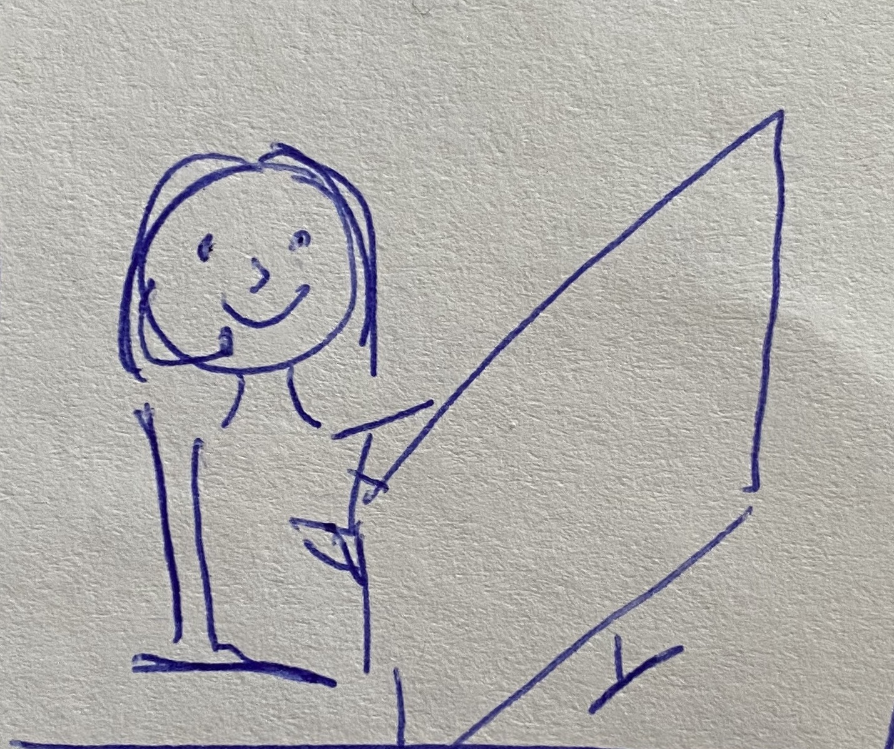
Kim, an emergency call centre operator, logs onto CENTRAL at the start of her shift.

Slide 2
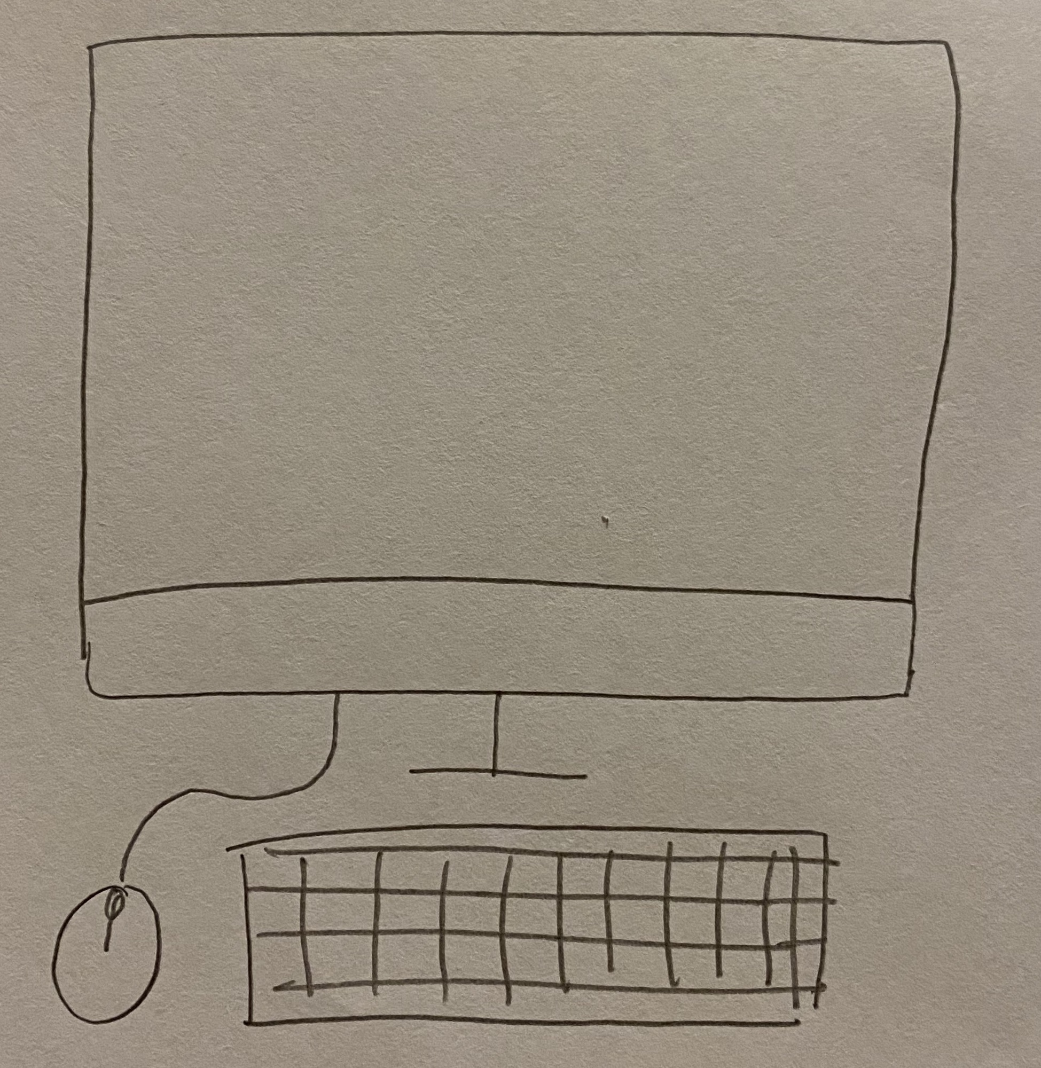
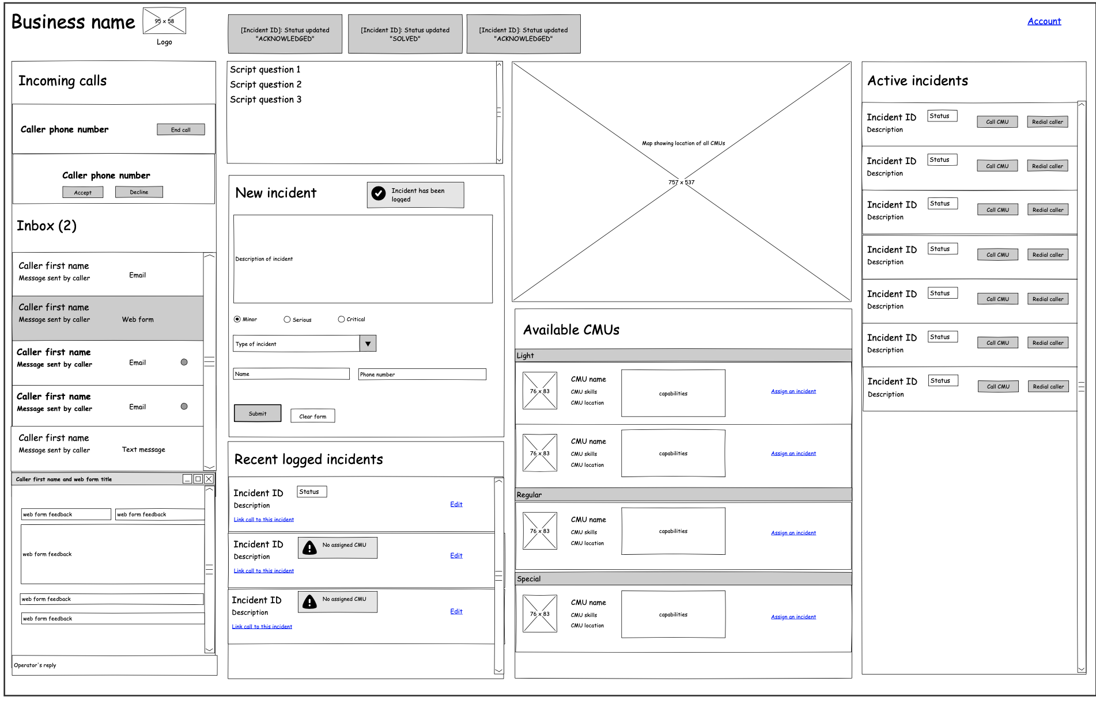
She is taken to the dashboard of the system. This shows the incoming communication from the customer, the script for communicating, active and past incidents, and CMU information.

Slide 3
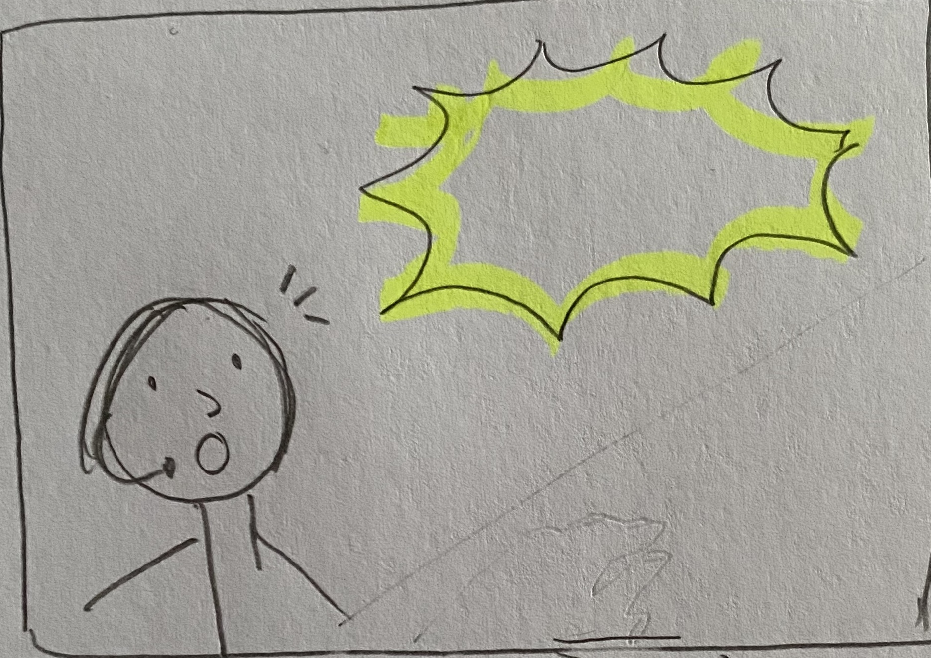
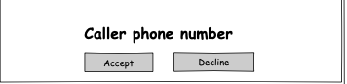
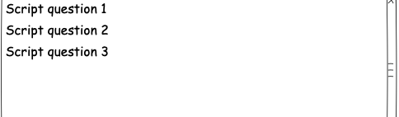
Introduction
An incoming call arrives. Kim selects the relevant script to show. For example, since this is a new call, she will select the “introduction” script so she knows what first to say to the caller.

Slide 4
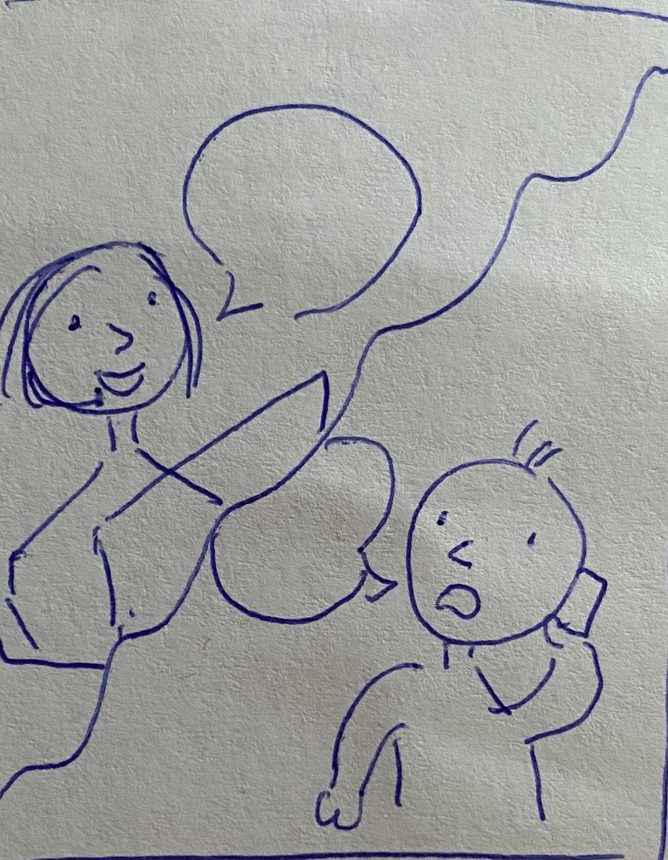
How may I help you today?
Hello, there’s ….
Kim accepts the call. She starts communicating with the caller; referring to the script for guidance

Slide 5
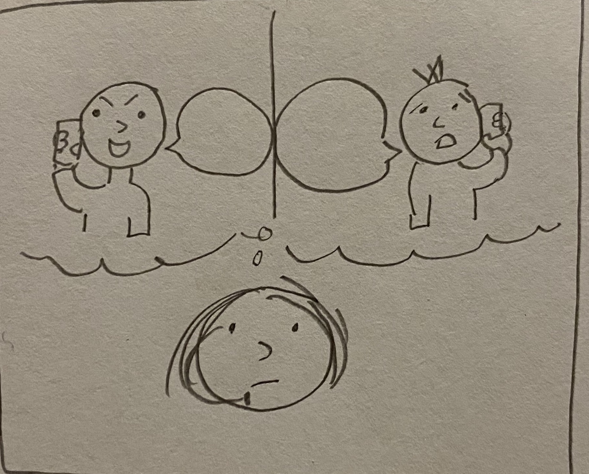
Haha!
Help!
During the call, Kim must make an appropriate judgement as to whether the call is genuine or not. If she believes it is a prank, she will end the call.

Slide 6
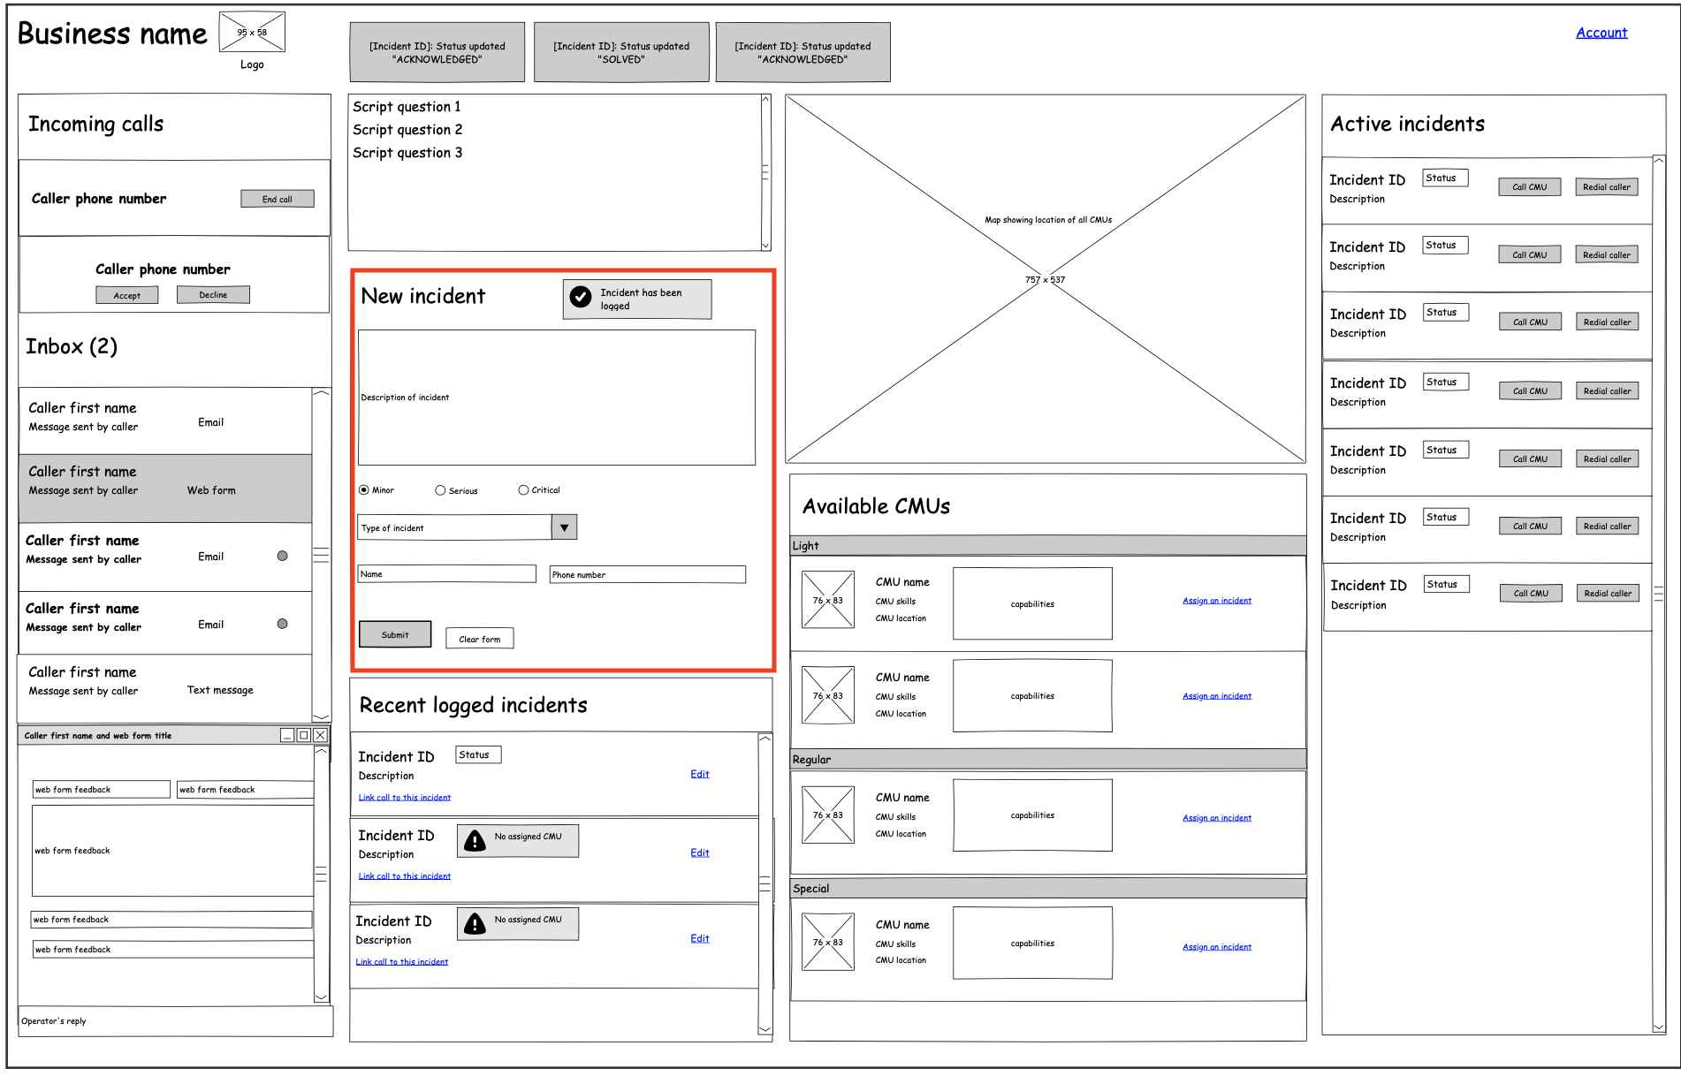
If Kim believes the call is about a new incident occurring, she will start filling in a “new incident” form, based on the information the caller is telling her.

Slide 7
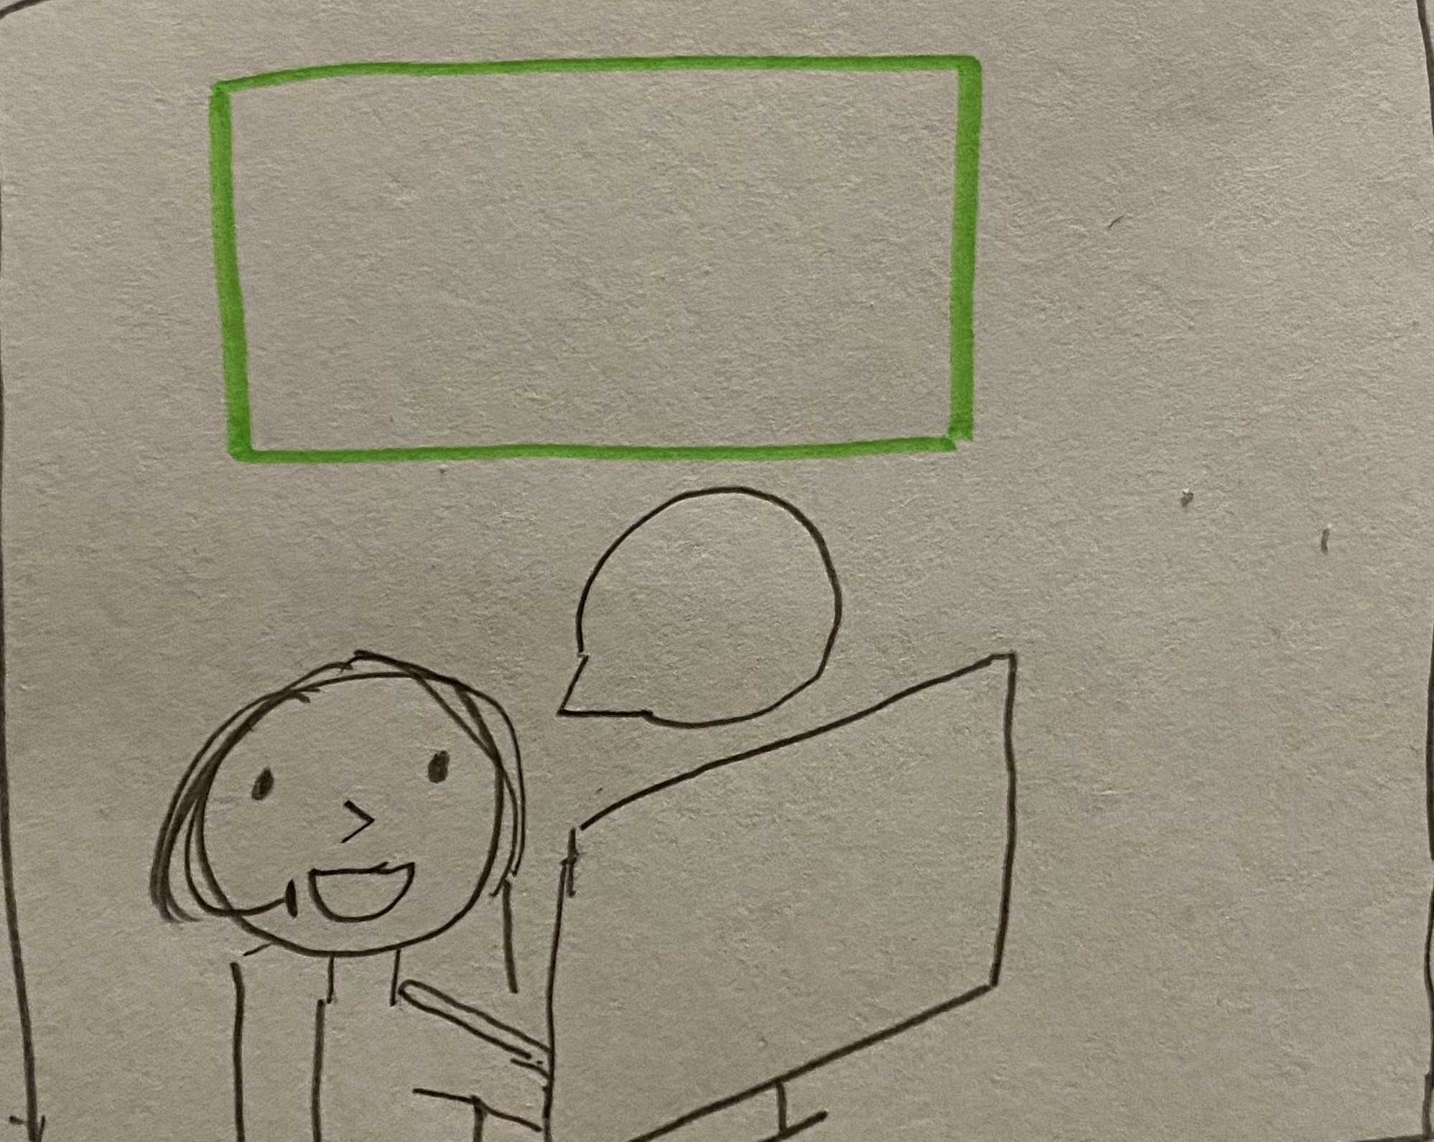
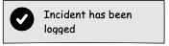
😃
Once Kim submits the form, the incident is logged into the incident log. She lets the caller know that it has been logged.

Slide 8
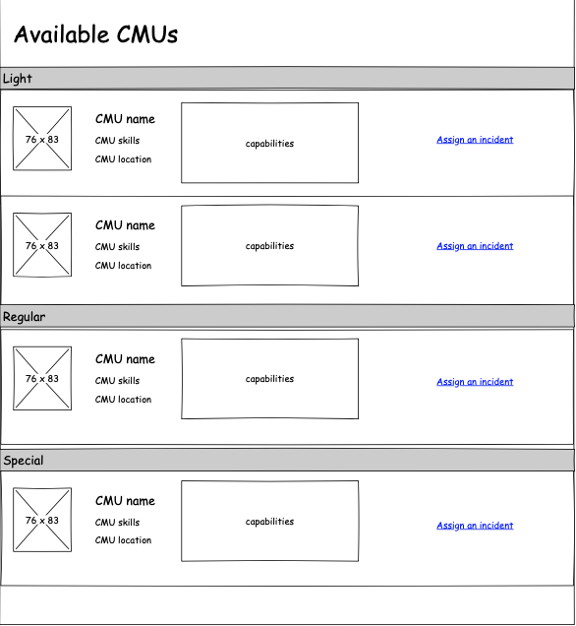
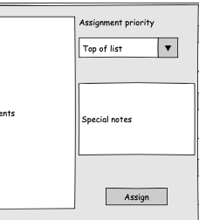

Kim then assigns the new incident to an appropriate CMU (light, regular or special CMU). She will then assign the priority of the assignment according to the information she received from the caller. She will then add any special notes about the incident that she feels the CMU will need to know.

Slide 9
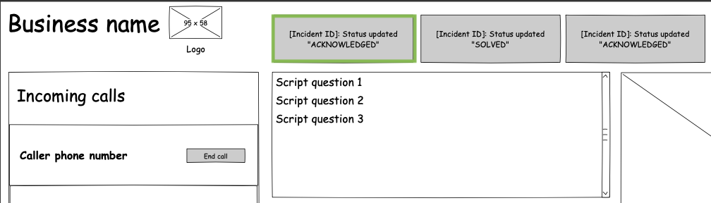
Notifications will appear at the top of the dashboard when there have been changes made to the incident. In this case, there is a notification that shows the update of the incident status to ”ACKNOWLEDGED”, as a CMU has now been dispatched to the incident.

Slide 10
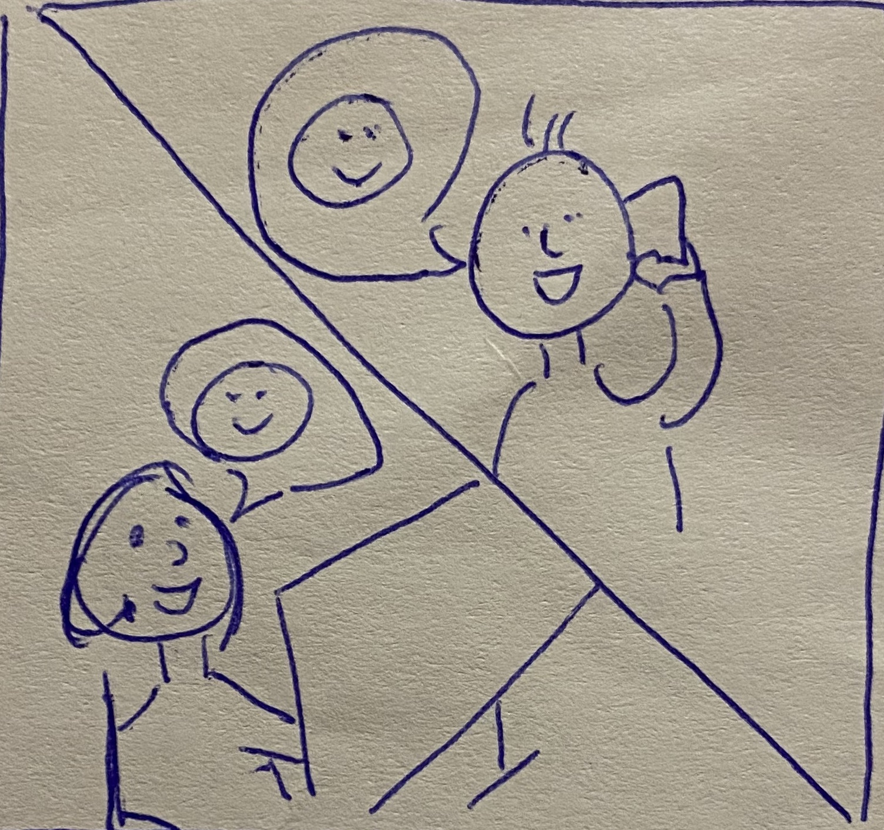
😃
😃
Kim will assure the caller that help is on its way. She will continue to stay on the line with the caller to help address any further questions they may have.

Slide 11
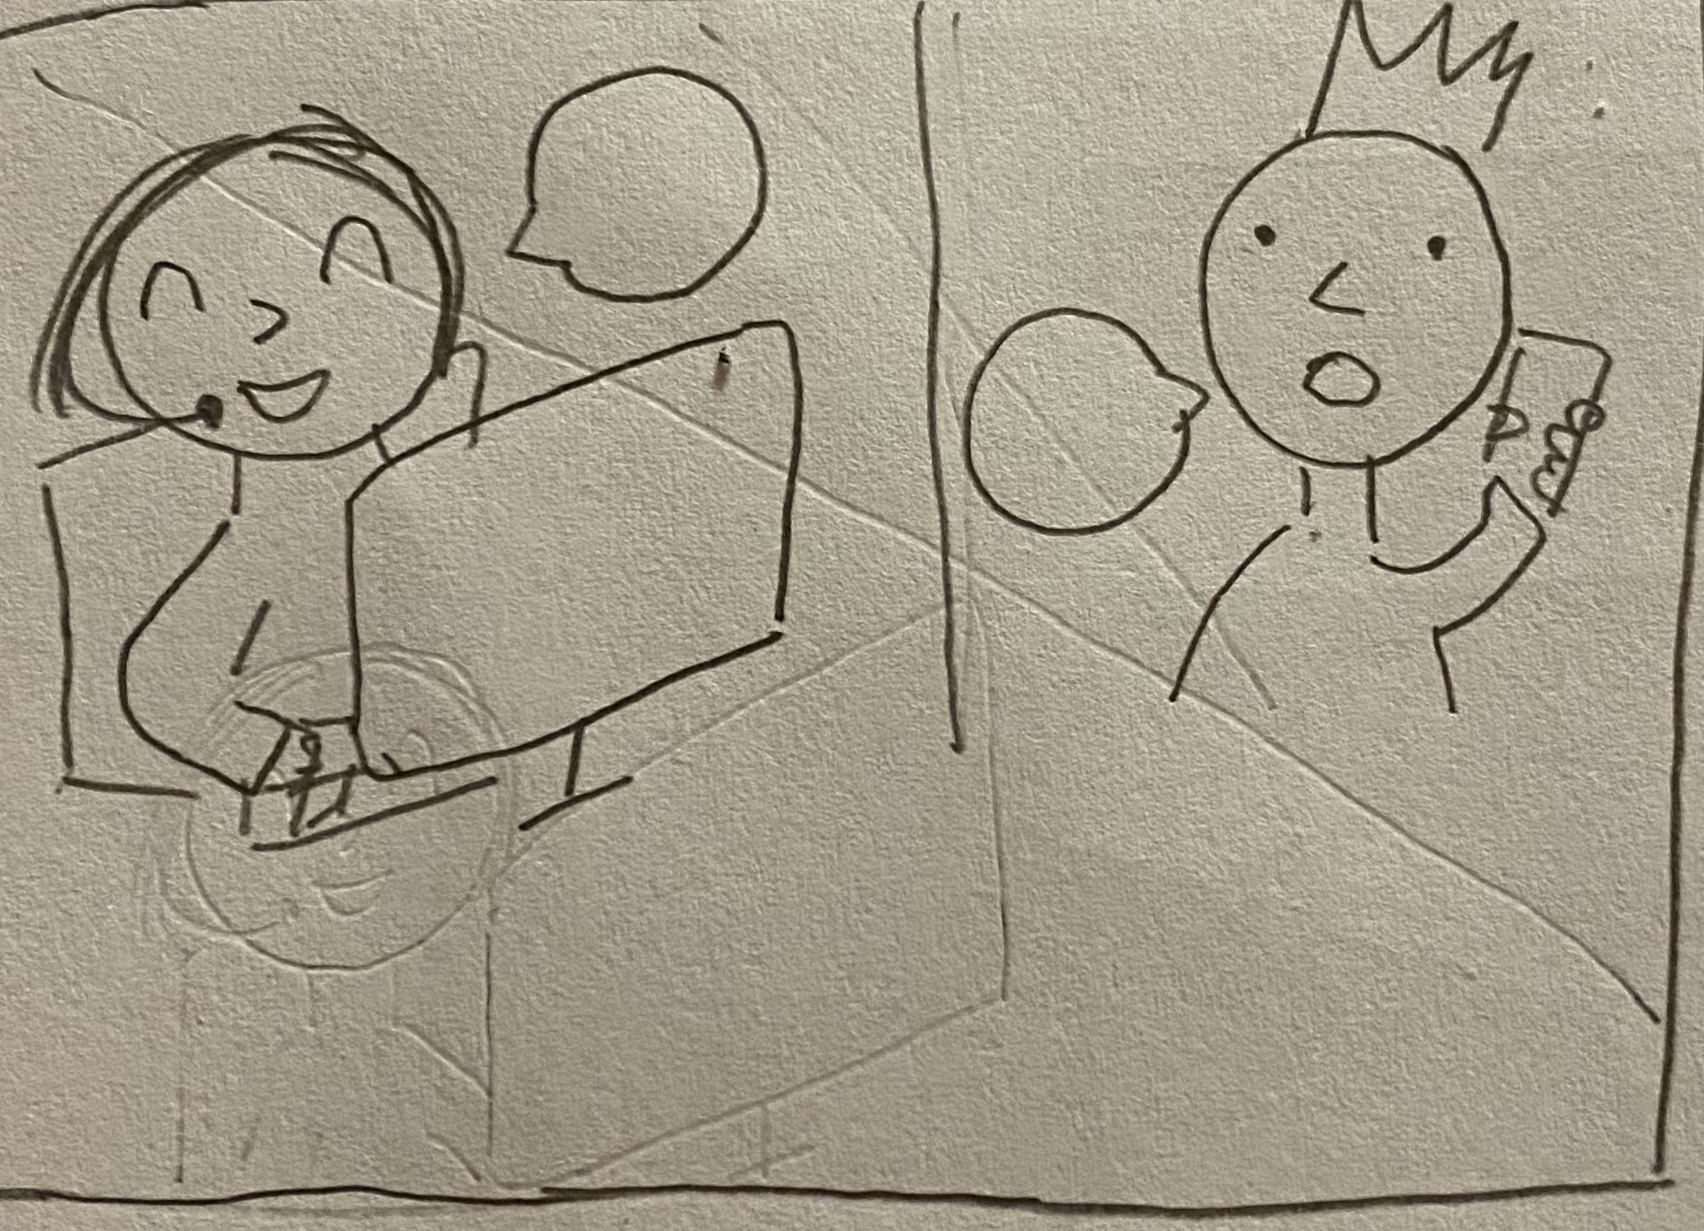
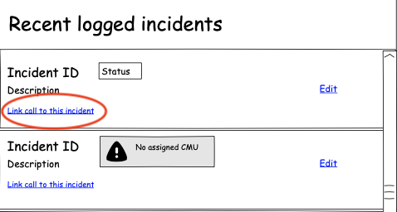
☺️
😟
Sometimes, other callers may call CENTRAL to report the same incident, even though the incident is already logged. In this case, Kim will reassure them that the incident is already being followed up, and she will link the caller’s details to the incident ID.

Slide 12
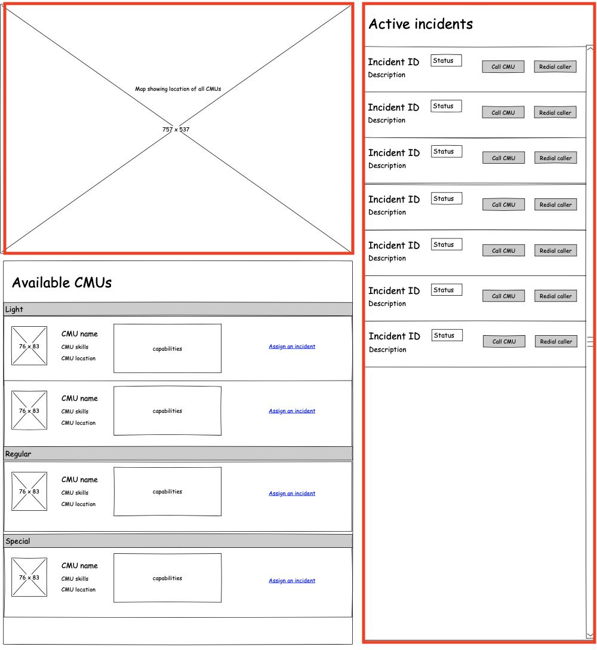
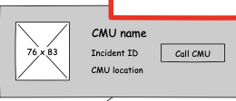
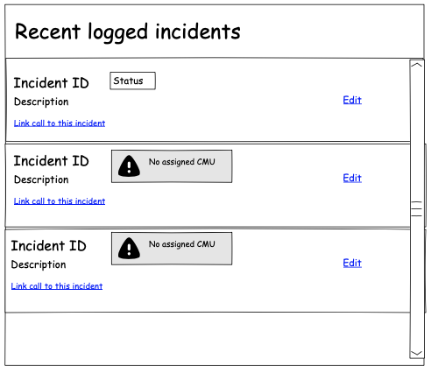
Kim can track the incident’s status on the map and in the active incidents log. On the map, she can view the real-time location of the CMU, and hover over the icon to view brief details of that CMU.

Slide 13
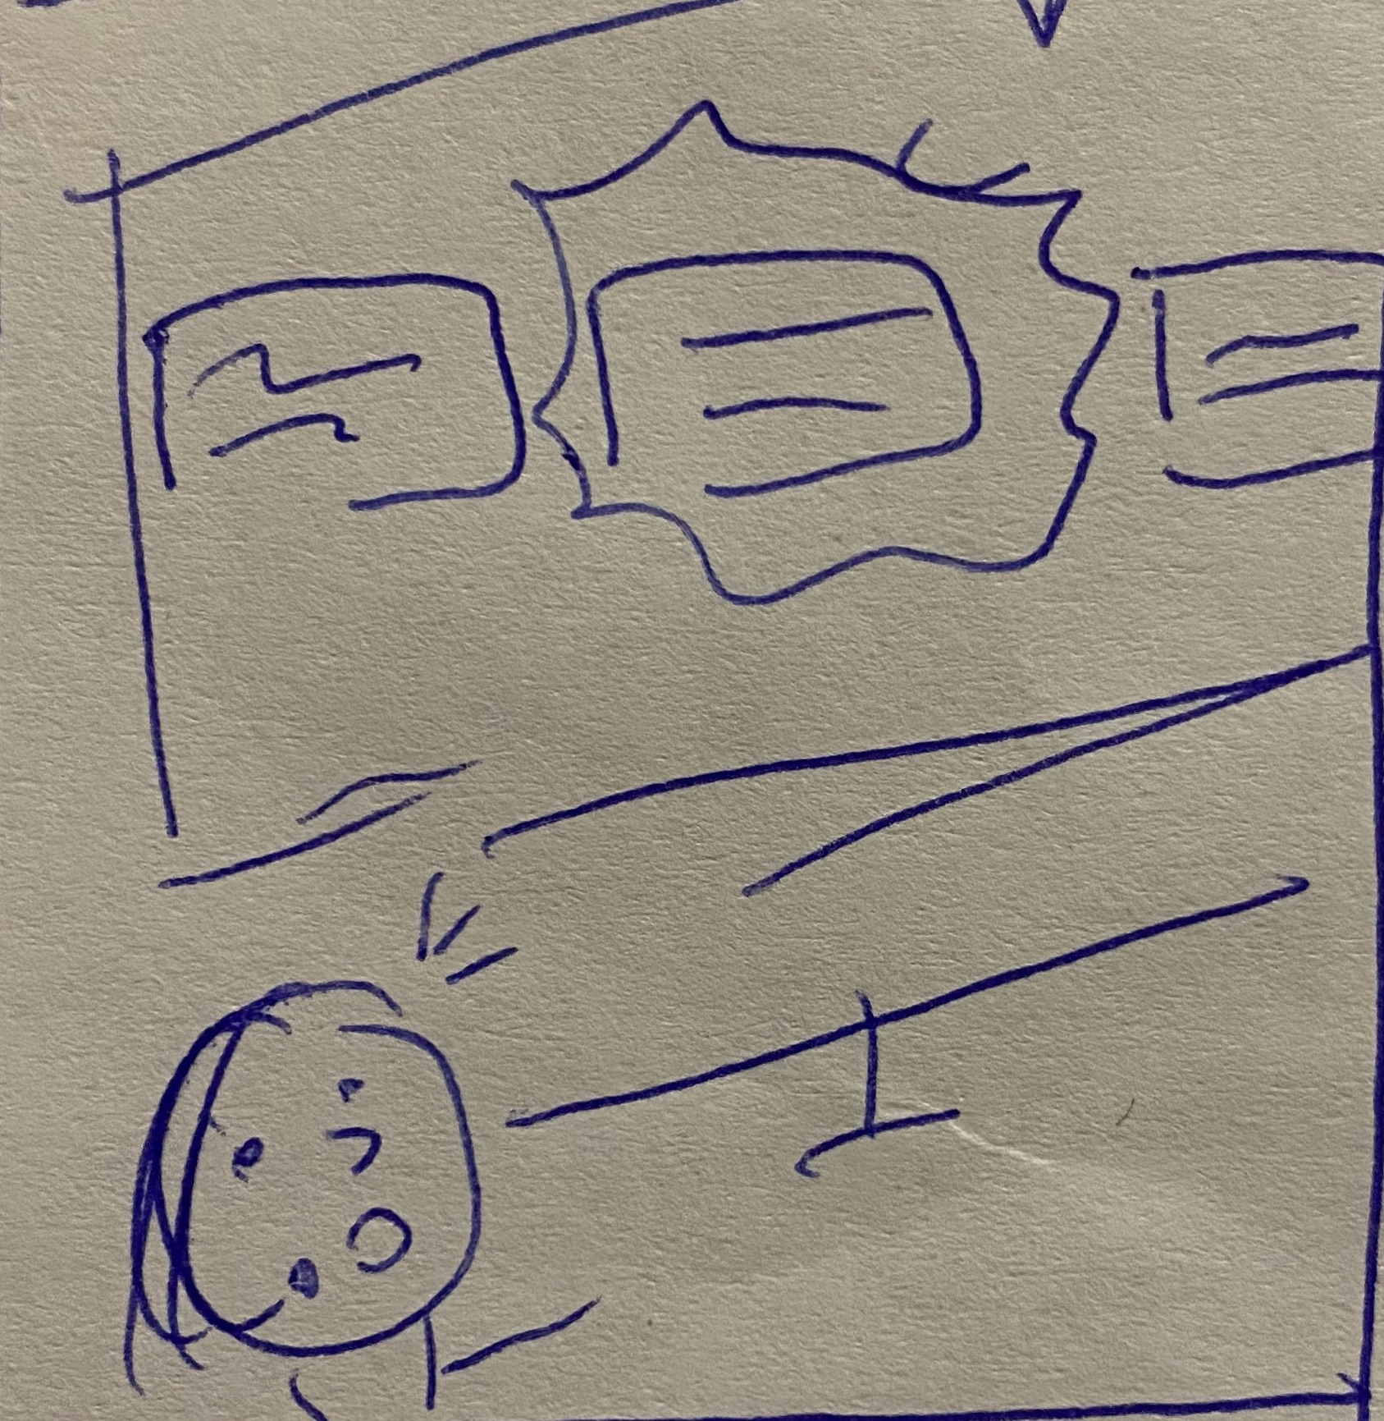
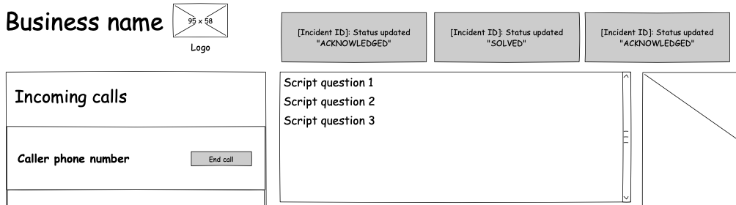
FAILED
In some cases, CMUs cannot solve an incident successfully. If this happens, a notification will appear at the top of the dashboard (same as previous) – except it will flash red to alert the operator. It will also not disappear from the dashboard until the operator has done something about it.

Slide 14
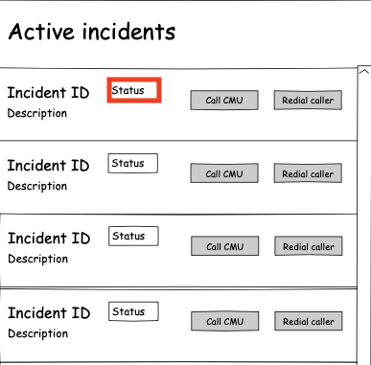
Critical
FAILED
Acknowledged
Minor
Actioned
Minor
Actioned
Critical
In this situation, Kim will have to check the incidents log to see what type of incident it is. If it is a ”critical” incident, she will need to assign a new CMU to that incident immediately.

Slide 15
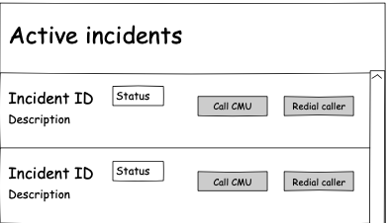
Hi Kim,
I need some more information about…
Here is the information I received from the caller…
The CMU may also request further information from the caller about the incident. They will communicate this with the operator through texts. Kim will need to then redial the caller (any who are linked with the incident) to get further information. Kim will then communicate this information back to the CMU through text.

Slide 16
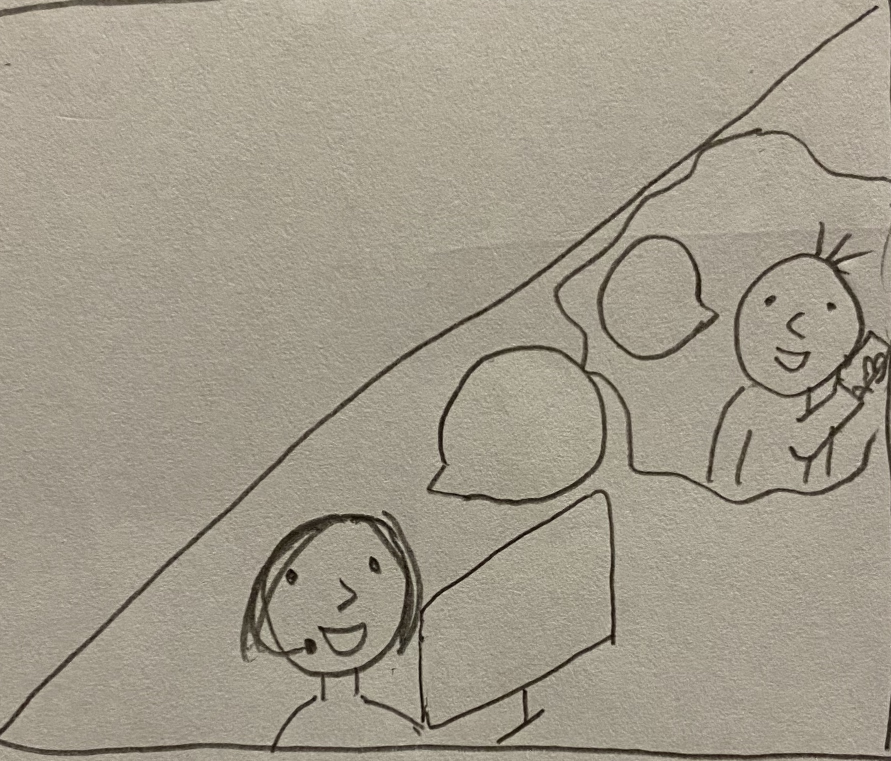
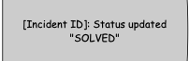
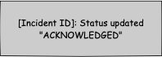
ACTIONED
😃
😃
When an incident is closed, the status will change from “ACKNOWLEDGED” to “ACTIONED” to “SOLVED”. Kim won’t have to redial the caller anymore. However, if the caller calls to check up on the situation, she can always look back at the “recent logged incidents” log to recall the incident.

